Slide 1
Reading Tables and Graphs: P- Value and Hypothesis Test Jaeseok Cho

Slide 2
Statistics in Political Science
What is statistics?
Why are we using statistics in social science?

Slide 3
Statistics
Data
Population
Sample

Slide 4
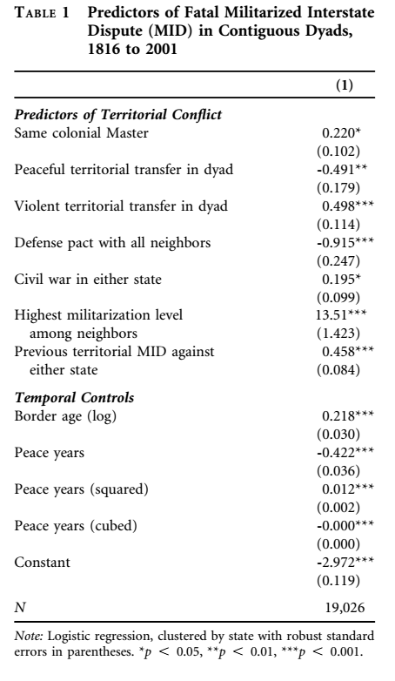
Let’s Apply

Slide 5
Examples
How can we assess the ‘true’ relationship between smoking & lung cancer (here, we assume smoking causes lung cancer)

Slide 6
Statistics
That is why we use statistics

Slide 7
Hypothesis test
Hypothesis: Smoking causes lung cancer
Is this true? How can we test this statement?
What is a p-value?
Notes:
Hypothesis testing and p-value
Sometimes, bad samples lead us to wrong inference; why good samples are important
Examples of bad sample

Slide 8
Examples of Bad Sample
1936 Literacy Digest Presidential Poll
Phone Survey by Literacy Digest
Survey Results: Republican
Actual Election: Democrats
Why?

Slide 9
Hypothesis test
Making hypothesis
Test the hypothesis

Slide 10
Examples
Does smoking cause lung cancer?

Slide 11
Hypothesis and P-Value
- Null Hypothesis and Alternative Hypothesis
Hypothesis testing is an assessment of statistical evidence
Often in social science experiments, experimenters set up an alternative hypothesis which they want to prove through the experiment

Slide 12
Hypothesis and P-Value
Let us imagine a hypothetical hospital which specializes in treating patients of lung cancer. Average expected survival time of patients who were treated in this hospital is μ= 1000 days and standard deviation σ= 49.
Suppose a medical research team at the hospital developed a new medical treatment to treat lung cancer.

Slide 13
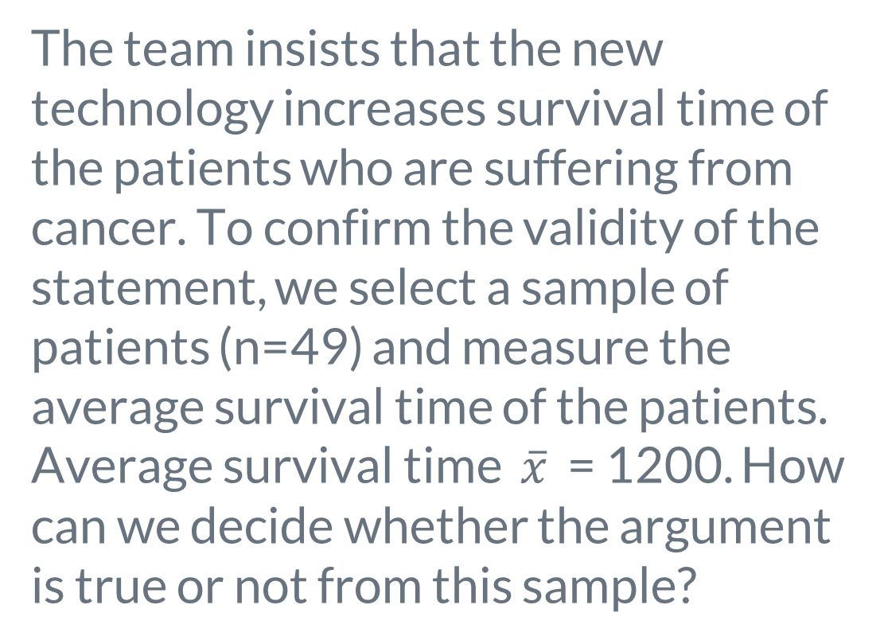
Hypothesis and P-Value
The team insists that the new technology increases survival time of the patients who are suffering from cancer. To confirm the validity of the statement, we select a sample of patients (n=49) and measure the average survival time of the patients. Average survival time $\overline{x}$ = 1200. How can we decide whether the argument is true or not from this sample?

Slide 14
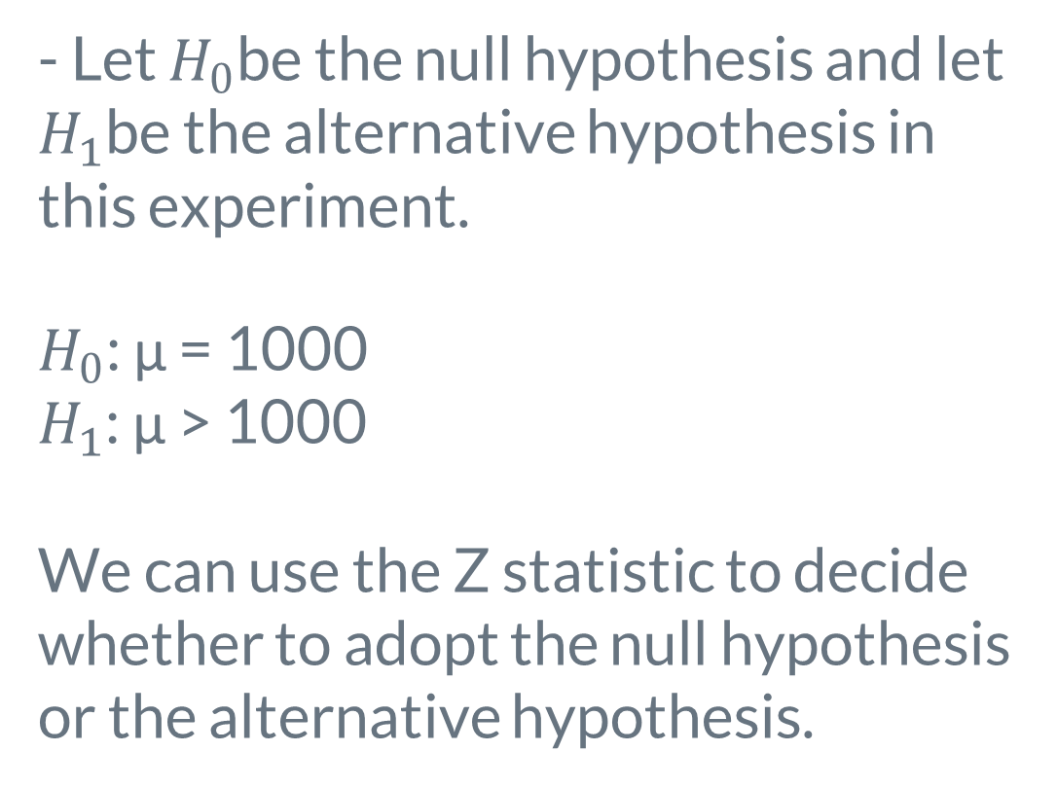
Hypothesis and P-Value
- Let $H_{0}$be the null hypothesis and let $H_{1}$be the alternative hypothesis in this experiment.
$H_{0}$: μ = 1000
$H_{1}$: μ > 1000
We can use the Z statistic to decide whether to adopt the null hypothesis or the alternative hypothesis.

Slide 15

Hypothesis and P-Value
$$z= \frac{\overline{x}− μ }{σ/\sqrt{n}}$$

Slide 16

Hypothesis and P-Value
$$z= \frac{\overline{x}− μ }{σ/\sqrt{n}}$$
$$= \frac{1200−1000 }{49/7}$$
= 28.57 > 1.645

Slide 17
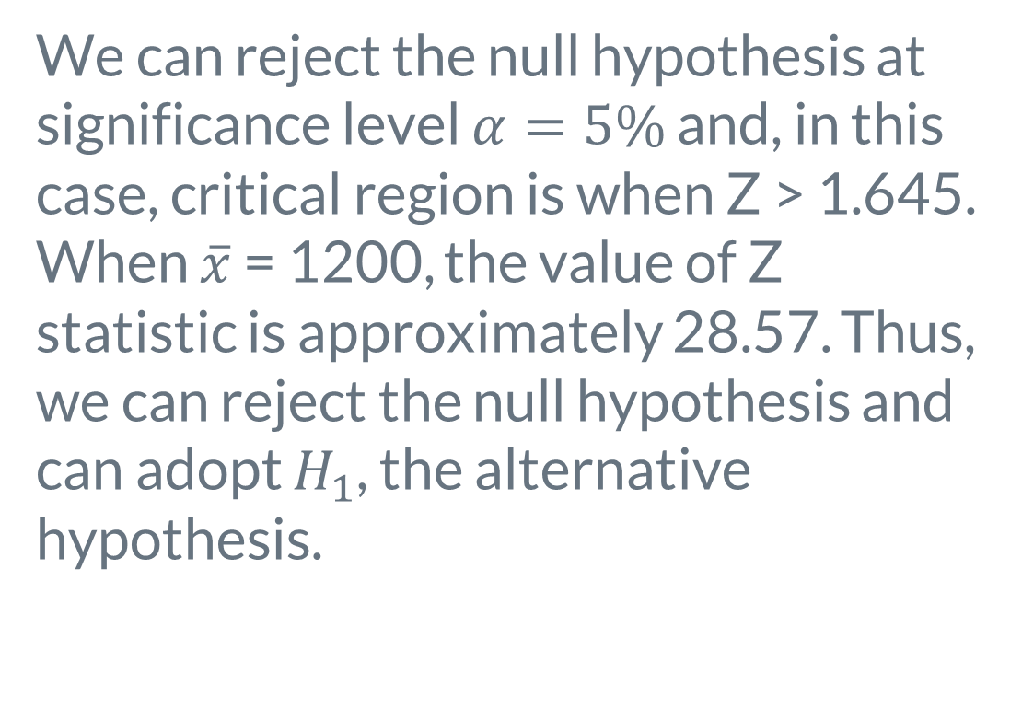
Hypothesis and P-Value
We can reject the null hypothesis at significance level $α=5\%$ and, in this case, critical region is when Z > 1.645. When $\overline{x}$ = 1200, the value of Z statistic is approximately 28.57. Thus, we can reject the null hypothesis and can adopt $H_{1}$, the alternative hypothesis.

Slide 18
Hypothesis and P-Value
- From this statistical hypothesis testing, we can show evidence supports the theory that the new medical technology may indeed have a positive impact on the survival time of patients of lung cancer.

Slide 19
SE
Standard deviation of Statistics
Standard errors can be used to compute confidence intervals. A 95% confidence interval is defined as a range of values such that with 95% probability, the range will contain true unknown value of the parameter in the population.

Slide 20
Coefficient
Simple Regression and Coefficient
Y = ax + b

Slide 21
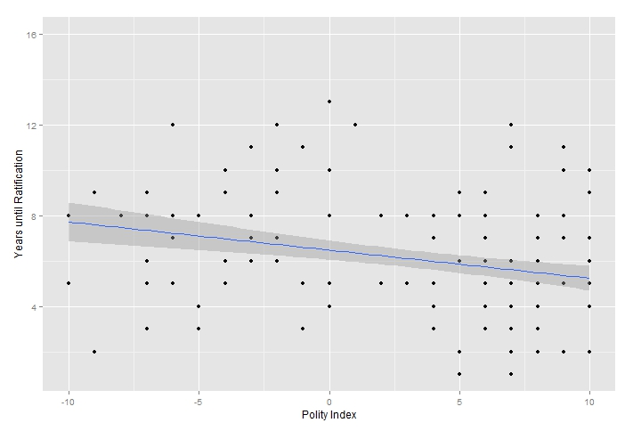
Coefficient

Slide 22
Let’s Apply Now

